Slide 1
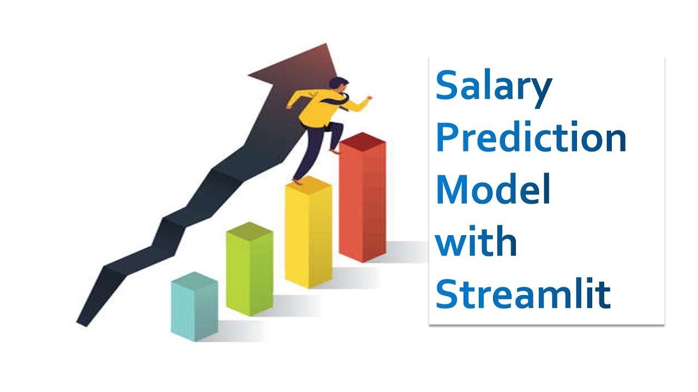
Employee Salary Prediction Using Machine Learning
CAPSTONE PROJECT
Presented By:
Aman Kumar Singh
Master Of Statistics
Amity School of Applied Sciences
Amity University Lucknow Campus
AICTE Internship Student Registration ID : STU67e8d6bdbacea1743312573
IBM SkillsBuild: jeetendra774401@gmail.com

Slide 2
OUTLINE
Problem Statement
System Development Approach
Algorithm & Deployment
Result
Conclusion
Future Scope
References

Slide 3
Problem Statement
This project aims to solve the problem of automated income classification by developing a machine learning model that can predict whether a person earns more than $50,000 annually based on their demographic and employment-related attributes. The solution features a user-friendly web application built with Streamlit, enabling real-time and batch predictions, making it accessible to users without a programming background.

Slide 4
Proposed Solution
To address the challenge of predicting individual income levels efficiently and accurately, we propose the following end-to-end solution:
Data Acquisition and Understanding
Utilize the Adult 3 Dataset containing demographic and employment information.
Analyze features such as age, education, occupation, marital status, and hours worked per week.
Data Preprocessing
Handle missing values and inconsistent entries.
Encode categorical variables using appropriate encoding techniques (e.g., Label Encoding).
Normalize or scale features where required.
Model Development
Train a supervised classification model (e.g., Gradient Boosting Classifier) using scikit-learn.
Evaluate model performance using metrics like accuracy, precision, recall, and F1-score.

Slide 5
Model Deployment
Serialize the trained model using joblib.
Build an interactive and responsive Streamlit web application for:
Real-time single predictions via sidebar input form.
Bulk predictions through CSV file upload.
User Accessibility and Visualization
Display input and prediction results using Streamlit UI elements.
Allow users to download prediction results in CSV format.
Provide visual feedback and success/error messages for user interaction.

Slide 6
System Approach
1. Hardware Requirements
Component | Minimum Specification
Processor | Intel Core i3 or above
RAM | 4 GB (8 GB recommended)
Storage | 500 MB of free disk space
Operating System | Windows 10 / Linux / macOS
Internet | Required for installing packages & deployment
2. Development Environment
IDE: Jupyter Notebook / VS Code / PyCharm
Model: Gradient Boosting Classifier (or any suitable ML algorithm)
App Framework: Streamlit
Model File: income_classifier.pkl

Slide 7
3. Software Requirements
Software/Tool | Version/Details
Python | 3.7 or above
Streamlit | Latest (e.g., 1.20+)
Scikit-learn | For machine learning model training
Pandas, NumPy | For data preprocessing and handling
Matplotlib, Seaborn | For data visualization (optional)
Joblib | For model serialization
Jupyter Notebook | For exploratory data analysis
Web Browser | For running and interacting with the app
4. Deployment Options
Local Deployment: Using streamlit run app.py

Slide 8
Algorithm & Deployment
Step 1: Data Collection
Download the Adult 3 Dataset
Load the dataset into a Jupyter Notebook using pandas for exploration.
Step 2: Data Preprocessing
Handle missing or unknown values (?, blank rows).
Convert categorical variables using Label Encoding.
Split the dataset into training and testing sets.
Step 3: Model Building
Choose a classification algorithm (e.g., Gradient Boosting, Random Forest, Logistic Regression).
Train the model on the training data using scikit-learn.
Evaluate model performance using accuracy, precision, recall, and F1-score.
Step 4: Model Serialization
Save the trained model using joblib: joblib.dump(model, 'income_classifier.pkl')

Slide 9
Step 5: Streamlit App Development
Create a Streamlit app with:
Sidebar input fields for single prediction.
File uploader for batch prediction via CSV.
Output display using st.success, st.write, and tables.
Step 6: Integration
Load the saved model (income_classifier.pkl) into the Streamlit app.
Ensure input features match model expectations.
Handle prediction logic and show results in the app.
Step 7: Testing the App
Test with valid single inputs from the sidebar.
Test with a properly formatted CSV for batch prediction.
Handle errors (e.g., missing columns, wrong data types) gracefully.
Step 8: Deployment
Option 1: Run locally using: streamlit run app.py
Final Output:
A fully functional web application that predicts income class based on user input or uploaded datasets.

Slide 10


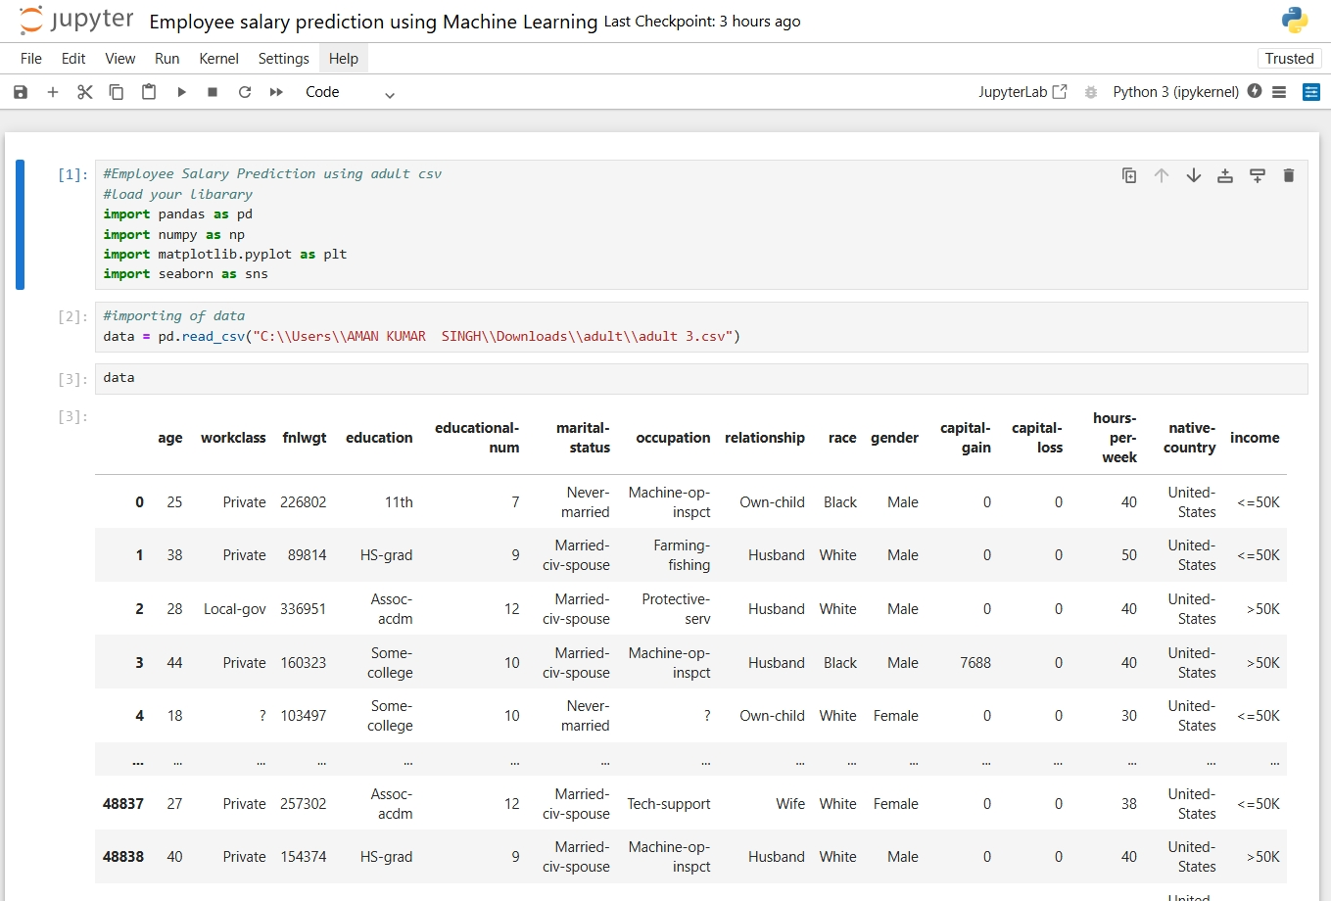

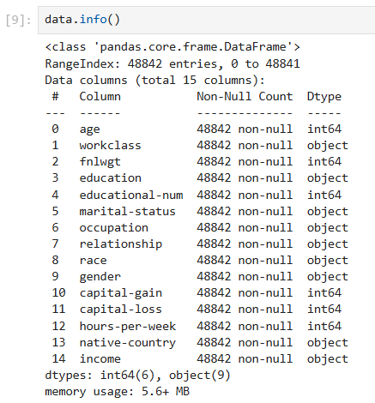
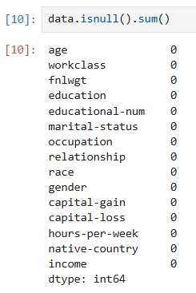
Result
GitHub link : https://github.com/amankumarsingh1092/Employee_Salary_Prediction_Using_Machine_Learning.git
Data set (drive link) : https://drive.google.com/file/d/185ef3lDodvbTbdsVZwUcMTqqWEOsydMW/view?usp=drive_link
Fig.02: Shape
Fig.01: Imported Dataset Preview
Fig.03: Sum of null values
Fig.04: Data information

Slide 11
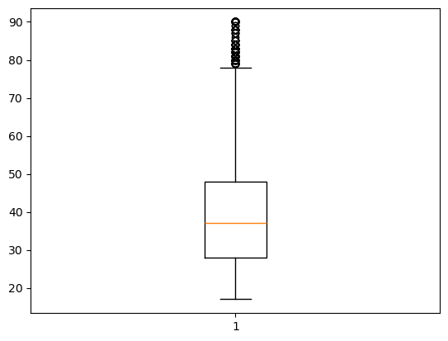
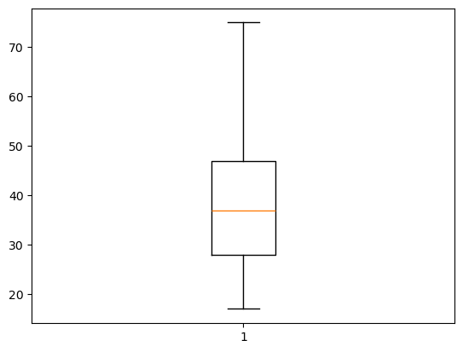
Fig.05: Boxplot with outliers (Age)
Fig.06: Boxplot without outliers (Age)

Slide 12
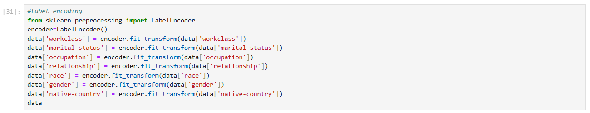
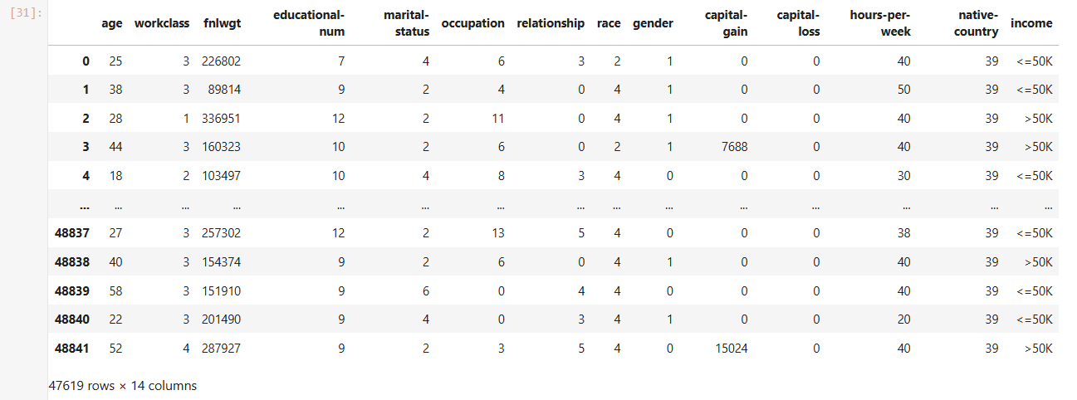
Fig.07: Label Encoding

Slide 13
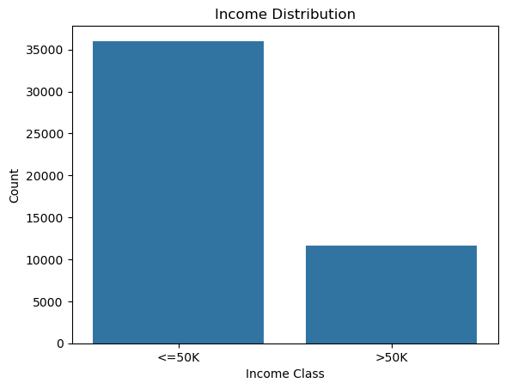
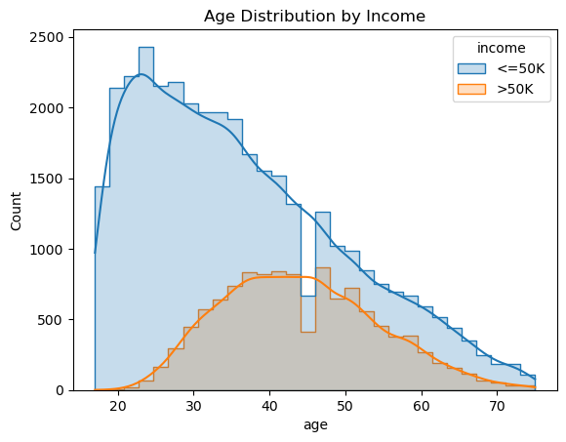
Fig.08: Distribution of Income Classes
Fig.09: Age Distribution by Income Class

Slide 14
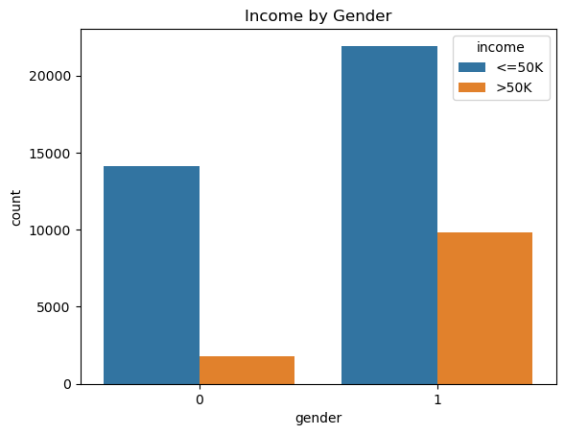
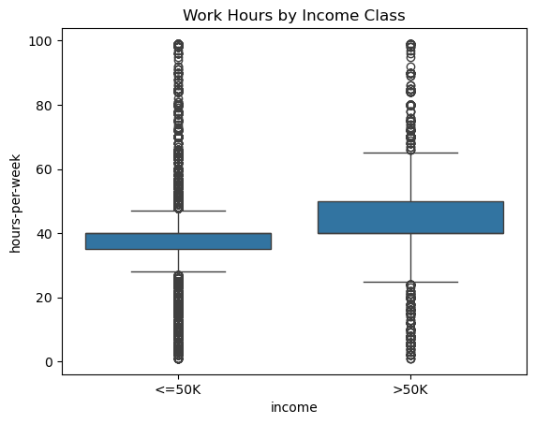
Fig.10: Gender vs Income
Fig.11: Hours Worked per Week vs Income (Boxplot)

Slide 15
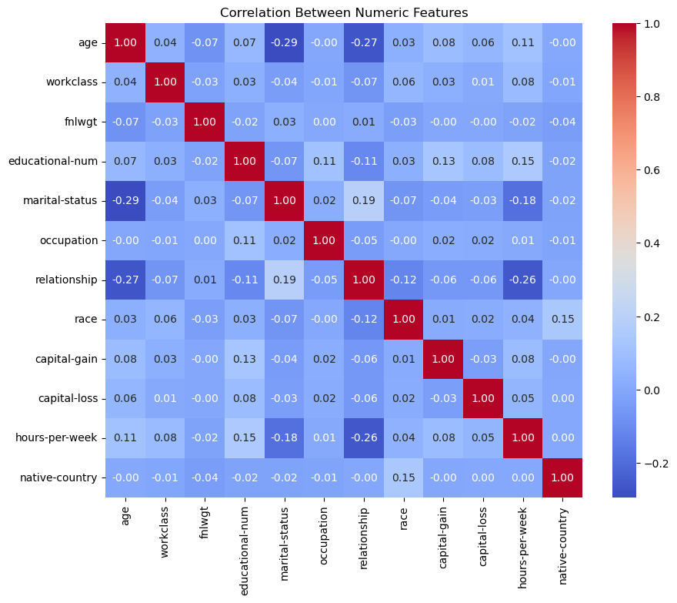
Fig.12: Correlation Heatmap (for numeric features)

Slide 16
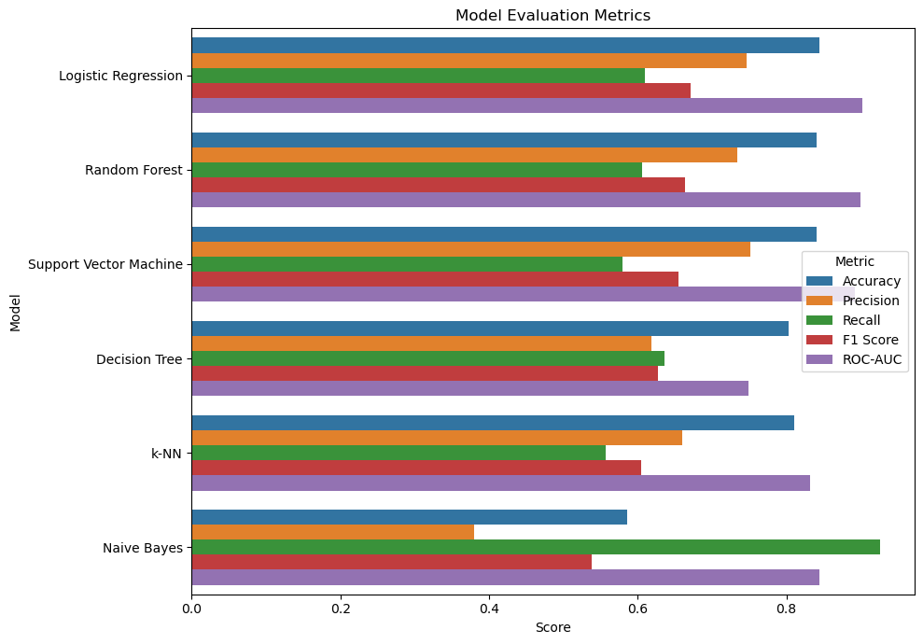
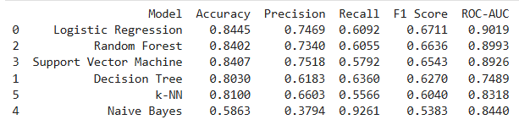
Fig.13: Model Evaluation Metrics

Slide 17
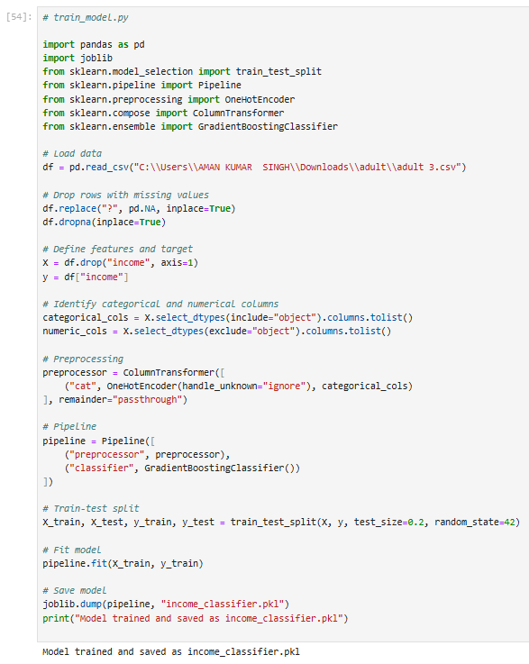
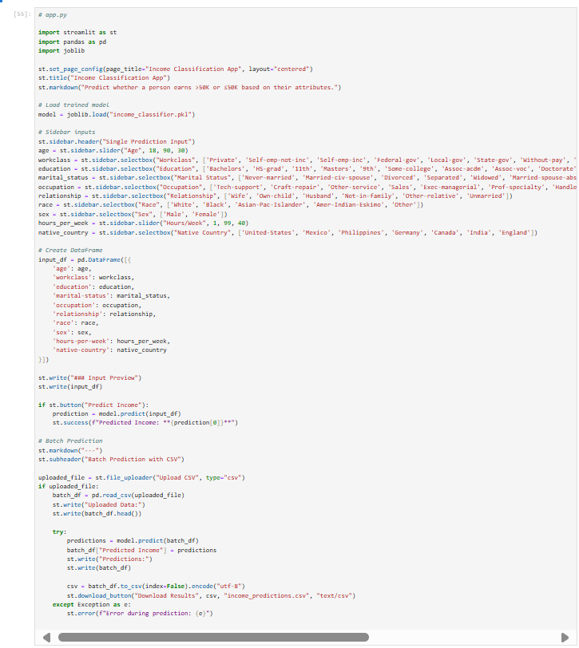
Fig.15: app.py
Fig.14: Train Model

Slide 18
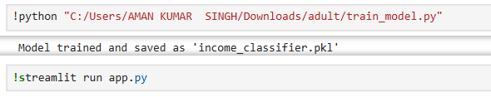
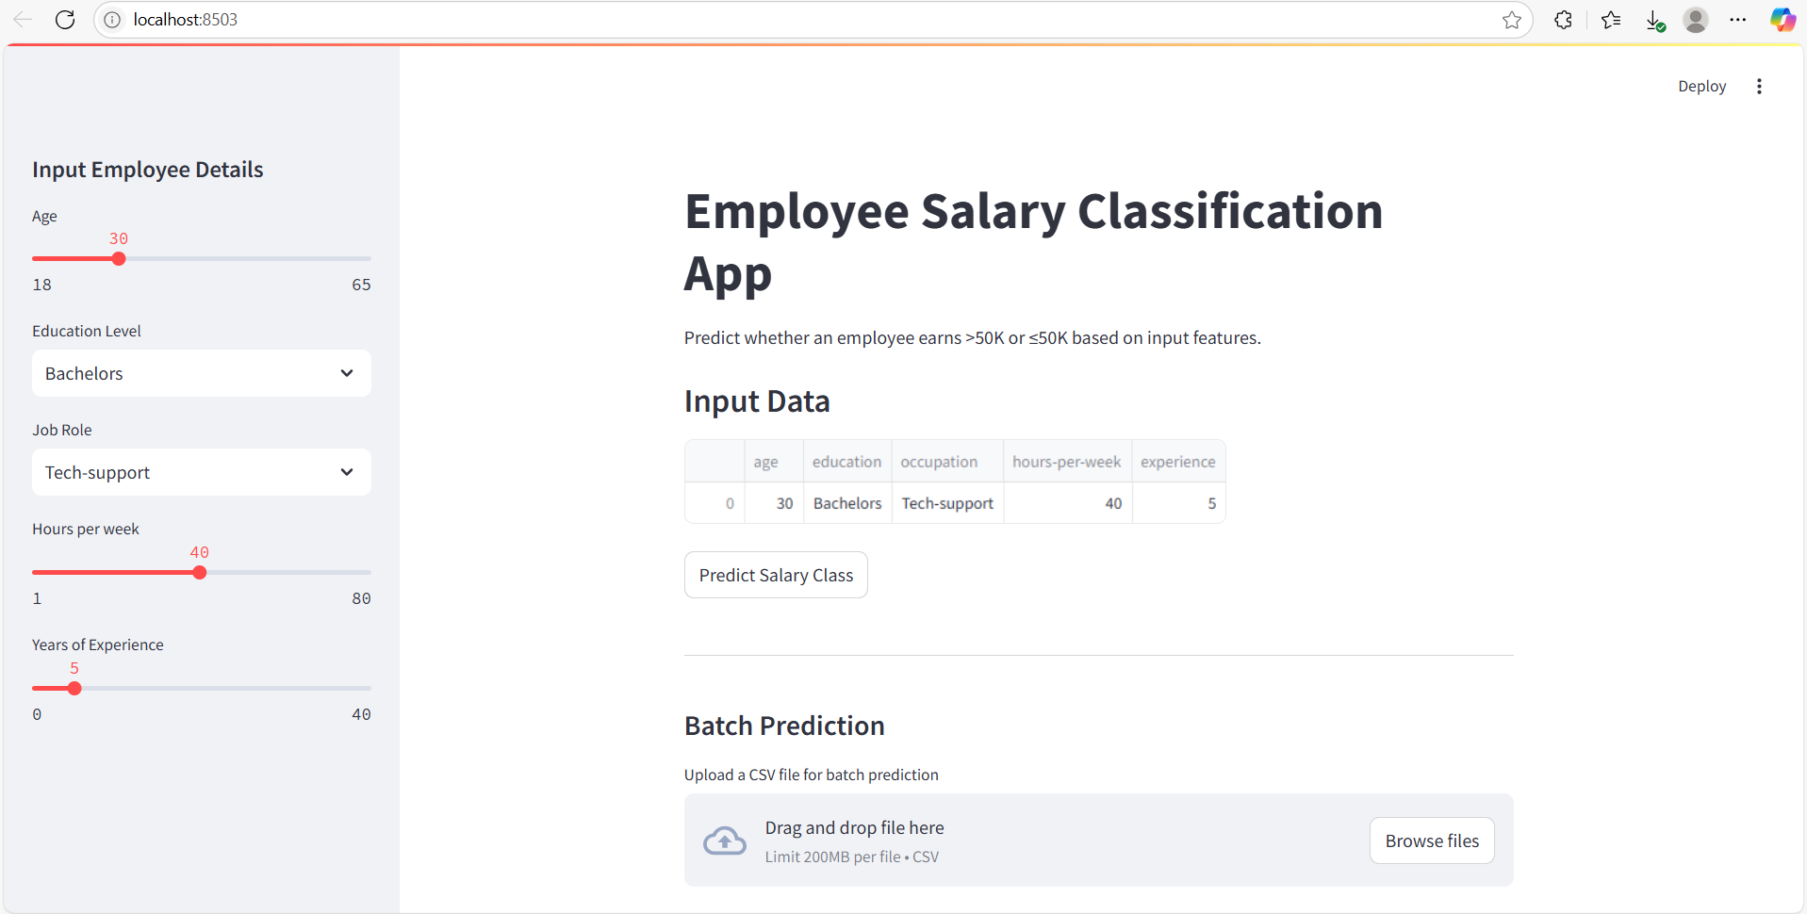
Fig.16: steamlit command
Fig.17: localhost:8503

Slide 19
Conclusion
The Employee Salary Prediction project successfully demonstrates the application of machine learning techniques to classify individuals based on their income levels. By using the Adult 3 dataset, we built and deployed a robust predictive model that determines whether an individual earns more than $50K annually based on demographic and employment-related features.
Through a systematic process of data preprocessing, feature selection, model training, evaluation, and deployment using Streamlit, this project highlights the effectiveness of supervised learning in real-world scenarios. The developed application is user-friendly, supports both single and batch predictions, and can be easily scaled or adapted for similar classification problems.
This project not only reinforces key concepts of data science and machine learning but also provides practical experience in end-to-end solution deployment — from raw data to real-time predictions.

Slide 20
Future scope
Model Enhancement: Incorporate more advanced algorithms like XGBoost, LightGBM, or deep learning models to improve prediction accuracy.
Feature Expansion: Add new socio-economic or regional features for deeper insights and improved model generalization.
Explainability: Integrate SHAP or LIME to provide interpretability of model decisions, increasing trust in predictions.
Real-time Integration: Deploy the model in a live production environment using cloud platforms (e.g., AWS, Azure, GCP).
Mobile Accessibility: Extend the app for mobile platforms for wider usability.
Income Regression: Extend the binary classification into a regression task to predict exact income values.

Slide 21
References
Adult3 Dataset (drive link ) https://drive.google.com/file/d/185ef3lDodvbTbdsVZwUcMTqqWEOsydMW/view?usp=drive_link
Github link (My Repository): https://github.com/amankumarsingh1092/Employee_Salary_Prediction_Using_Machine_Learning.git
Scikit-learn: Machine Learning in Python Pedregosa, F., et al. (2011). Scikit-learn: Machine Learning in Python. Journal of Machine Learning Research, 12, 2825–2830. https://scikit-learn.org/
Pandas Documentation McKinney, W. (2010). Data Structures for Statistical Computing in Python. Proceedings of the 9th Python in Science Conference. https://pandas.pydata.org/
Streamlit: Turn Python Scripts into Web Apps https://streamlit.io/ (Used to develop and deploy the web application.)
Joblib Library Documentation https://joblib.readthedocs.io/ (Used for saving and loading the machine learning model.)
Matplotlib & Seaborn Documentation https://matplotlib.org/ https://seaborn.pydata.org/ (Used for data visualization and exploration.)
Hands-On Machine Learning with Scikit-Learn, Keras, and TensorFlow Aurélien Géron (2019). O’Reilly Media, 2nd Edition. (Conceptual guide for model training, evaluation, and deployment.)

Slide 22
THANK YOU

